Slide 1

MOVIE RECOMMENDER SYSTEMS
MENTORS
Vijit Singh​
Kanav Bansal
TEAM
Koukuntla Komal Reddy​
Chalumuri Harshitha​
Chintada Jagan Mohan Rao
Koppaka Yeswanth ​
Kalapala Venkata Surya Teja​
Asif Ahmad Najar​

Slide 2
AGENDA
Problem Statement
Dataset Analysis with EDA
Model Justification
​Interpretation of Results
Implementation with Streamlit
Final Result
Challenges faced and Improvements
Timeline
References

Slide 3
Problem statement
Recommendation systems are becoming increasingly important in today’s extremely busy world. People are always short on time with the myriad tasks they need to accomplish in the limited 24 hours. Therefore, the recommendation systems are important as they help them make the right choices, without having to expend their cognitive resources.
The purpose of a recommendation system basically is to search for content that would be interesting to an individual. Moreover, it involves a number of factors(ratings, cast, genre, review) to create personalized lists of useful and interesting content specific to each user/individual

Slide 4

Dataset analysis with EDA

Slide 5
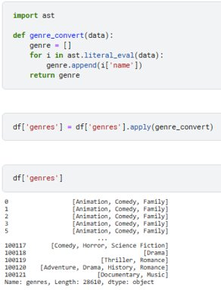
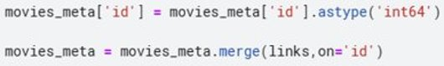
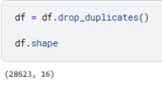
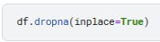
MERGING AND CLEANING DATASET
This conversion is also done for crew,cast,production_companies, keywords,spoken_languages too

Slide 6
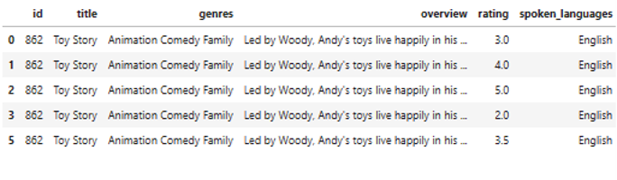
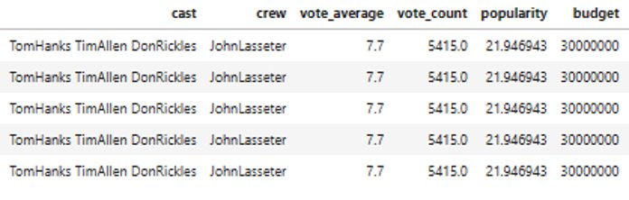
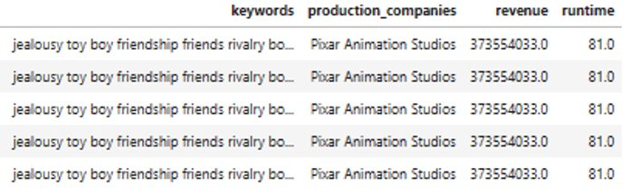
FINAL DATASET
With 16 columns and 28610 entries

Slide 7

MULTIVARIATE ANALYSIs

Slide 8
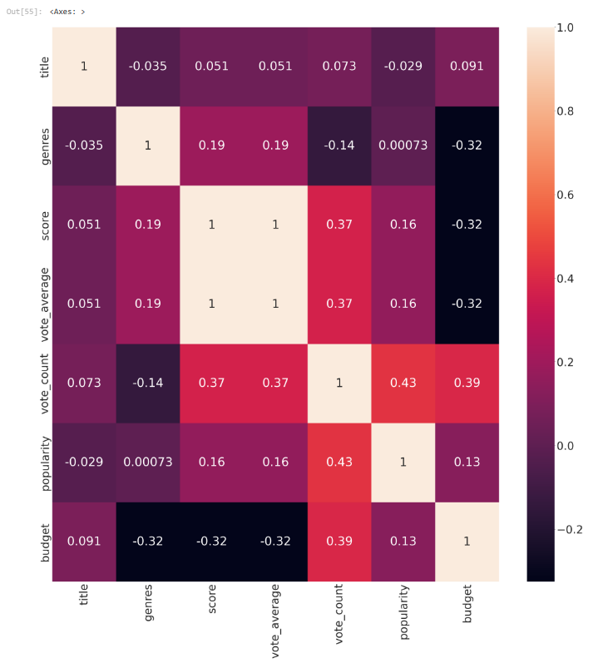
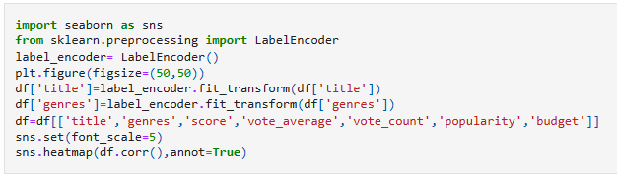
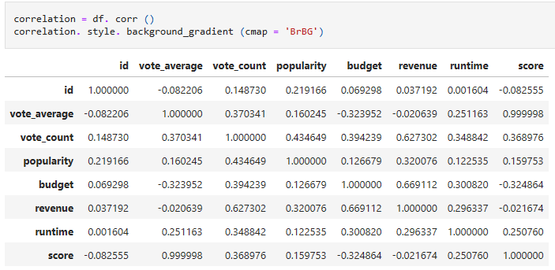

Slide 9
BIVARIATE ANALYSIs

Slide 10
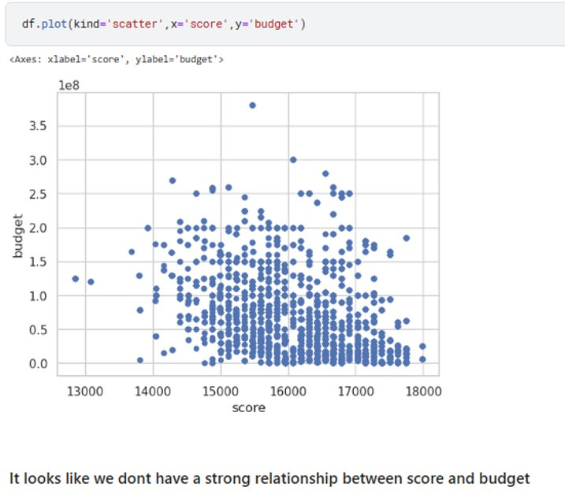
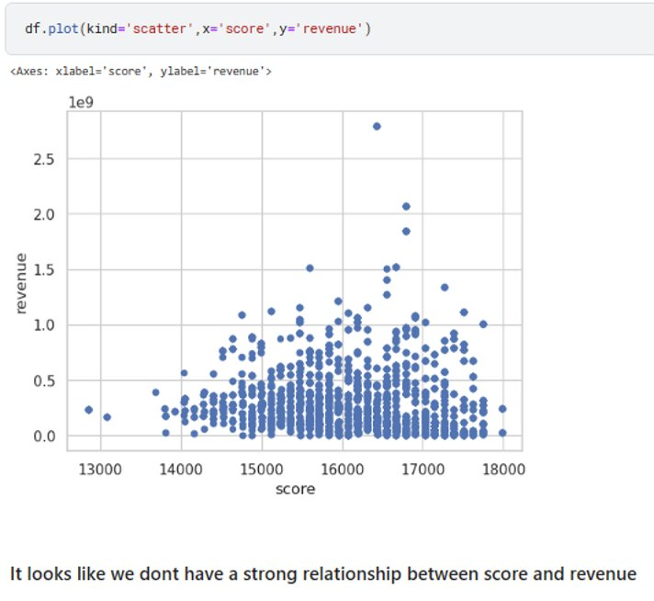
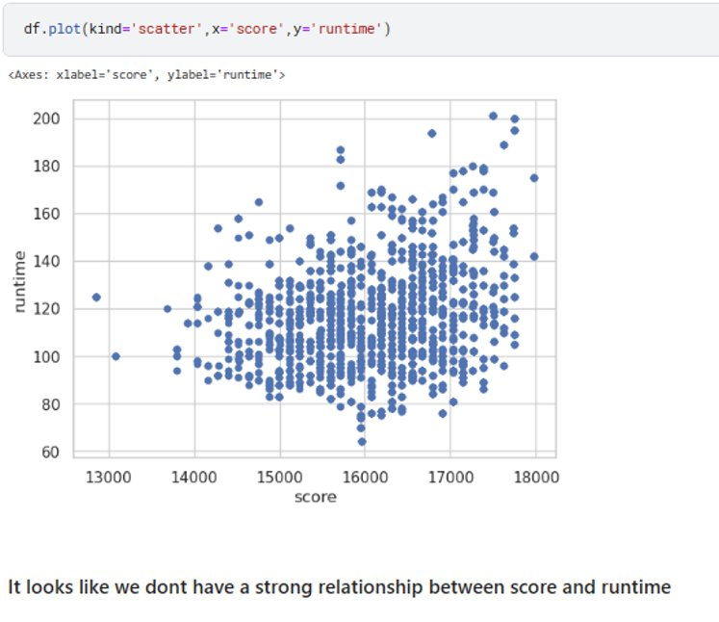
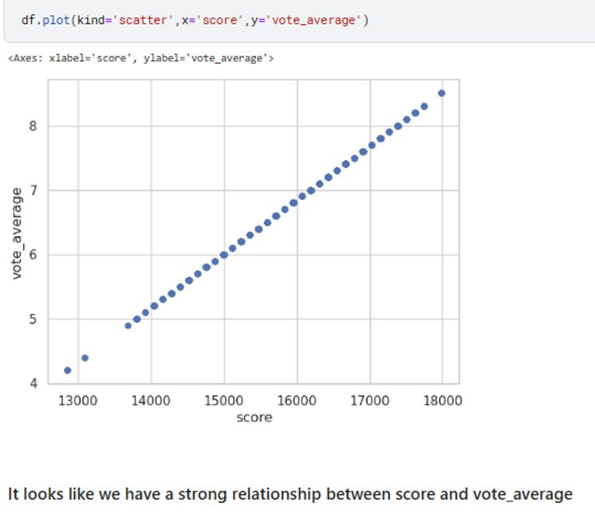
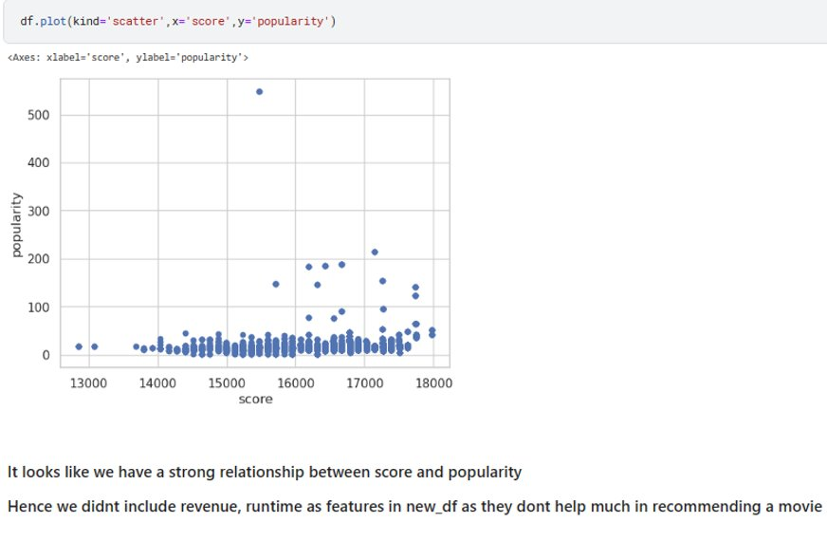

Slide 11
UNIVARIATE ANALYSIs

Slide 12
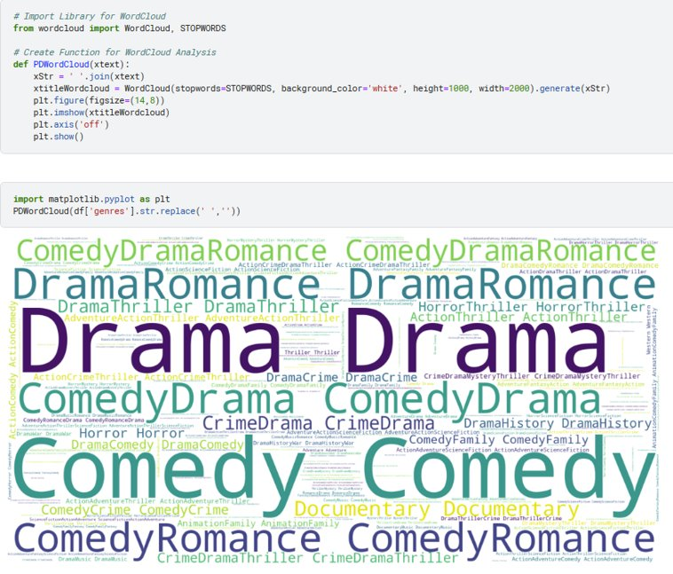
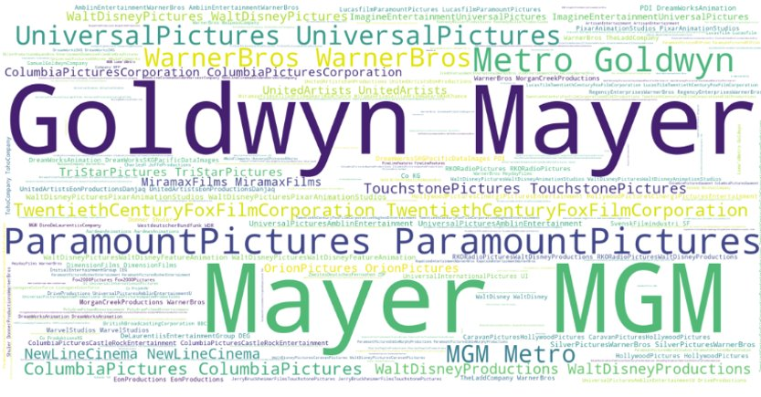

Slide 13
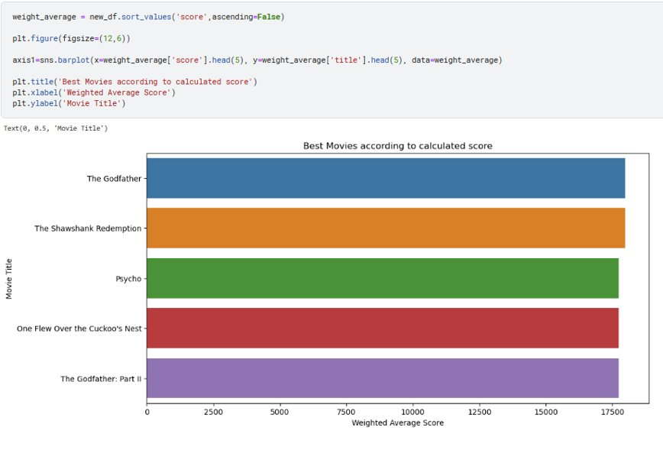
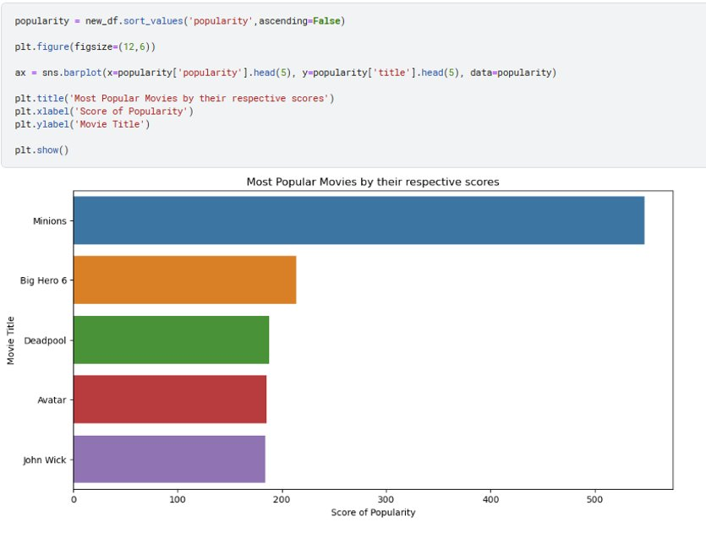
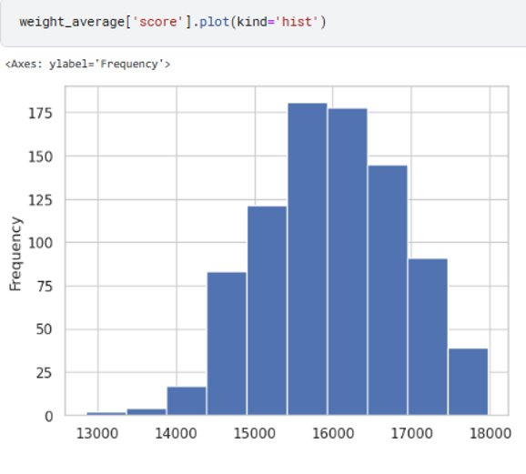

Slide 14
MODEL JUSTIFICATION

Slide 15
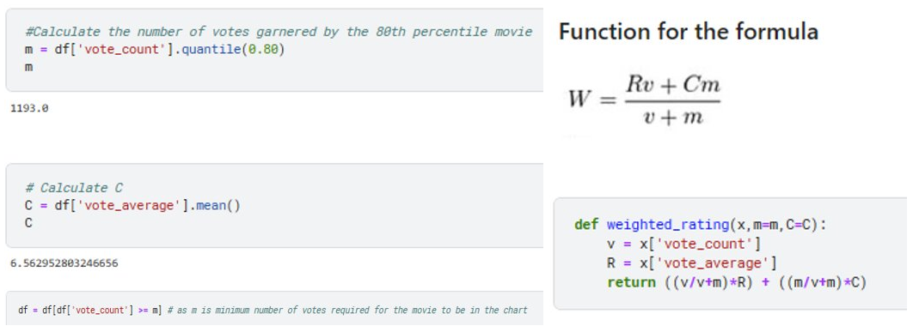
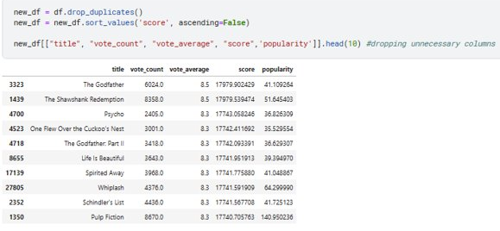
POPULARITY BASED RECOMMENDATION SYSTEM
We don’t have an appropriate metric for popularity based recommendation system and it doesn’t use any information regarding user behavior like which movie he/she is interested in past and which movie they are more likely to watch in future
It just recommends based on ratings and votes . Even though a movie has high rating and votes the user may not be interested in it, Thus popularity based recommendation system is not suitable for deploying as it may not satisfy user requirements

Slide 16
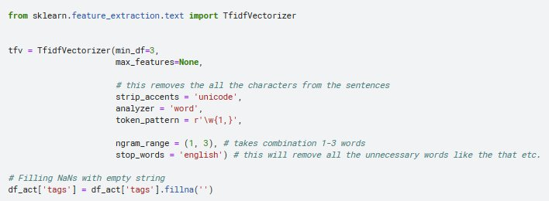
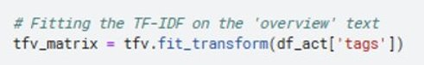
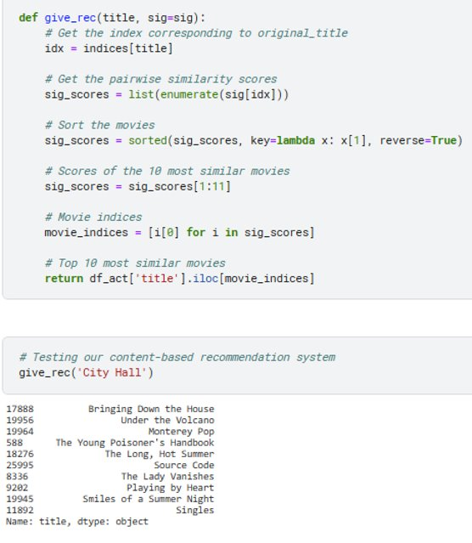
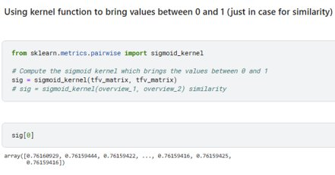
CONTENT BASED RECOMMENDATION SYSTEM
Content based recommendation focuses on item's information and doesn’t require user data, Content based system works really well in predicting a movie related to a movie but doesn’t analyze what user wants to watch next?
Similar items are usually grouped based on their features. But we need a recommendation system to also user data for much better user experience

Slide 17
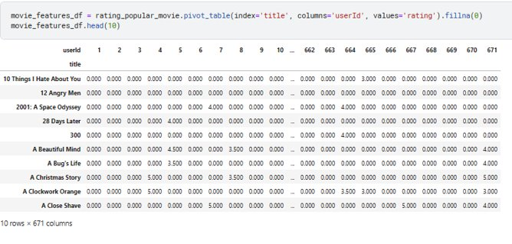
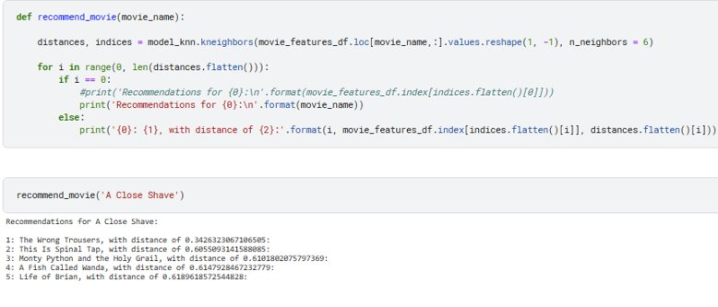
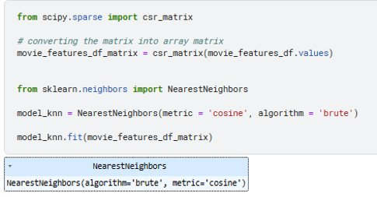
COLLABORATIVE BASED RECOMMENDATION SYSTEM
The main idea that governs the collaborative methods is that through past user-item interactions when processed through the system, it becomes sufficient to detect similar users or similar items to make predictions based on these estimated facts and insights. It recommends an item to user A based on the interests of a similar user B
The collaborative filtering method does not need the features of the items to be given. Every user and item is described by a feature vector or embedding
This recommendation system is preferred for deploying as it ensures user requirements taken into consideration and also predicts the movie related to past watch movies .

Slide 18
INTERPRETATION OF RESULTS

Slide 19
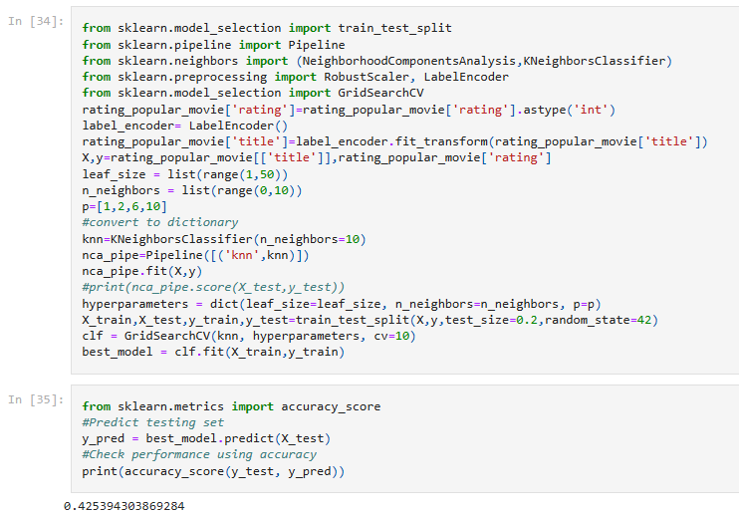
COLLABORATIVE BASED RECOMMENDATION SYSTEM
GridSearchCV is a technique for finding the optimal parameter values from a given set of parameters in a grid. It's essentially a cross-validation technique.

Slide 20

IMPLEMENTATION WITH STREAMLIT

Slide 21
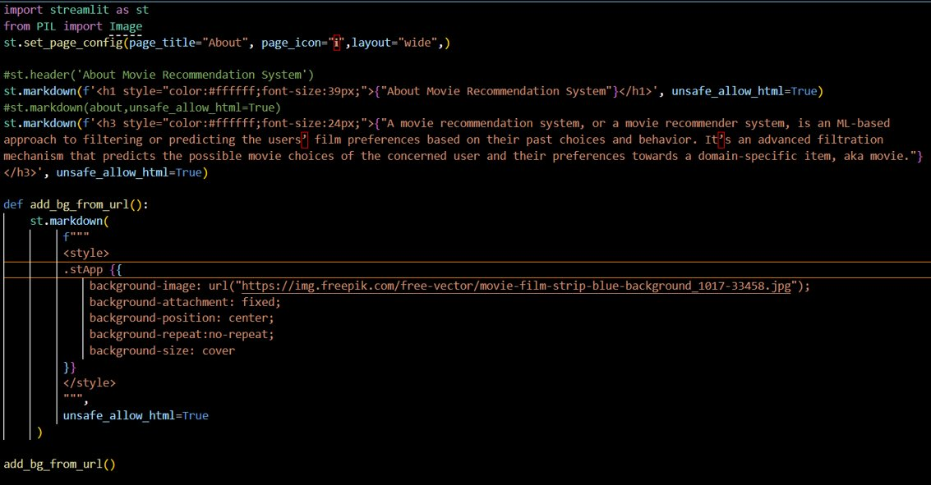
About.py File

Slide 22
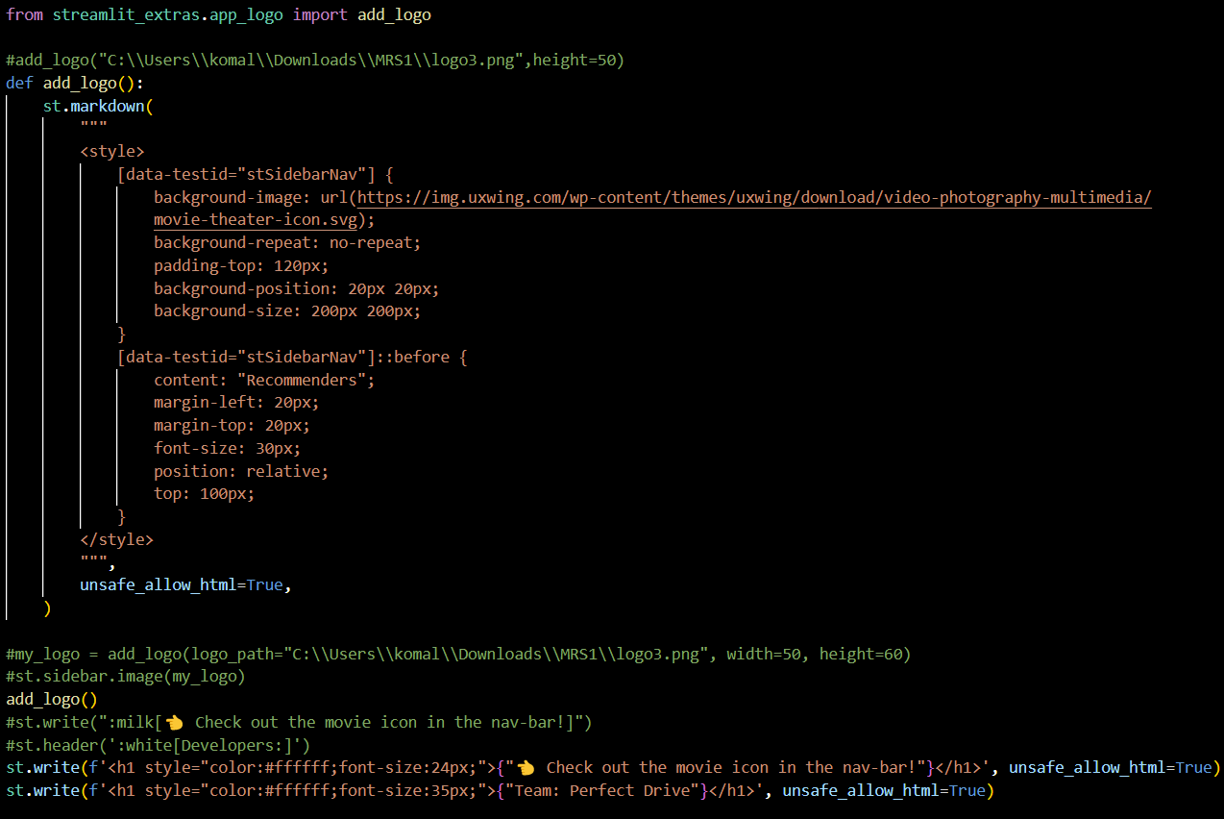

Slide 23
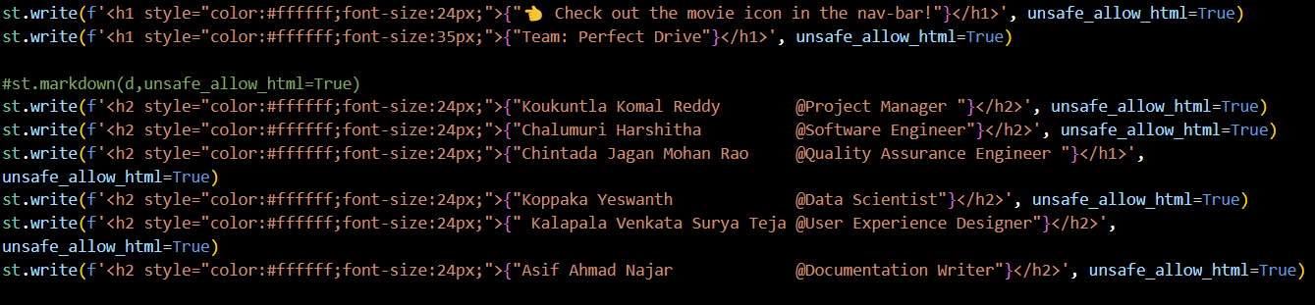
In the pages folder we will be having Collaborative Based Recommendation.py file

Slide 24
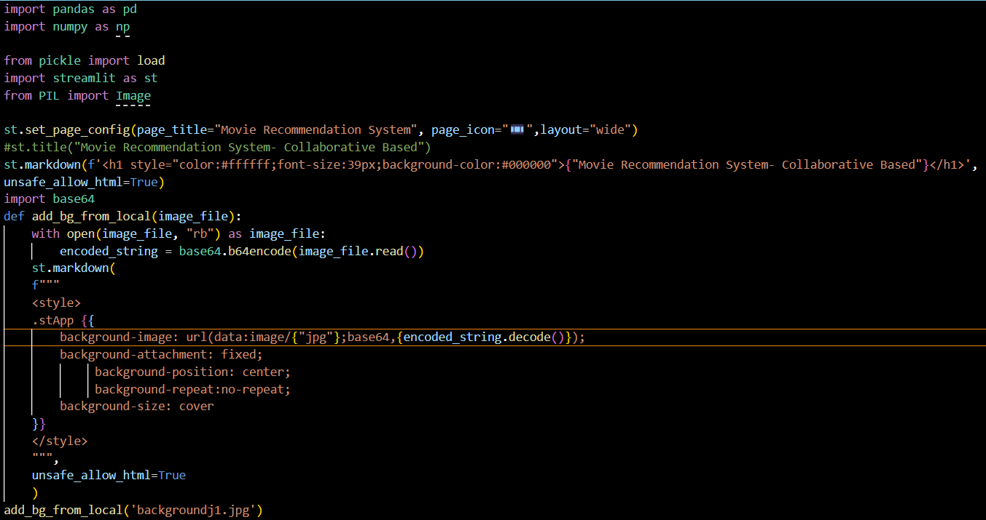
Collaborative Based Recommendation.py File

Slide 25
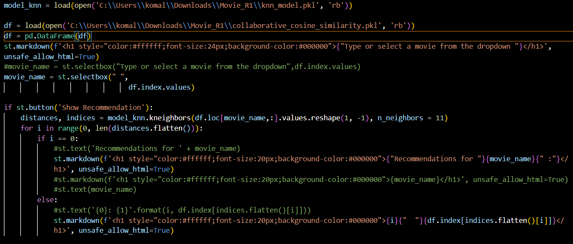

Slide 26
Final RESULT

Slide 27
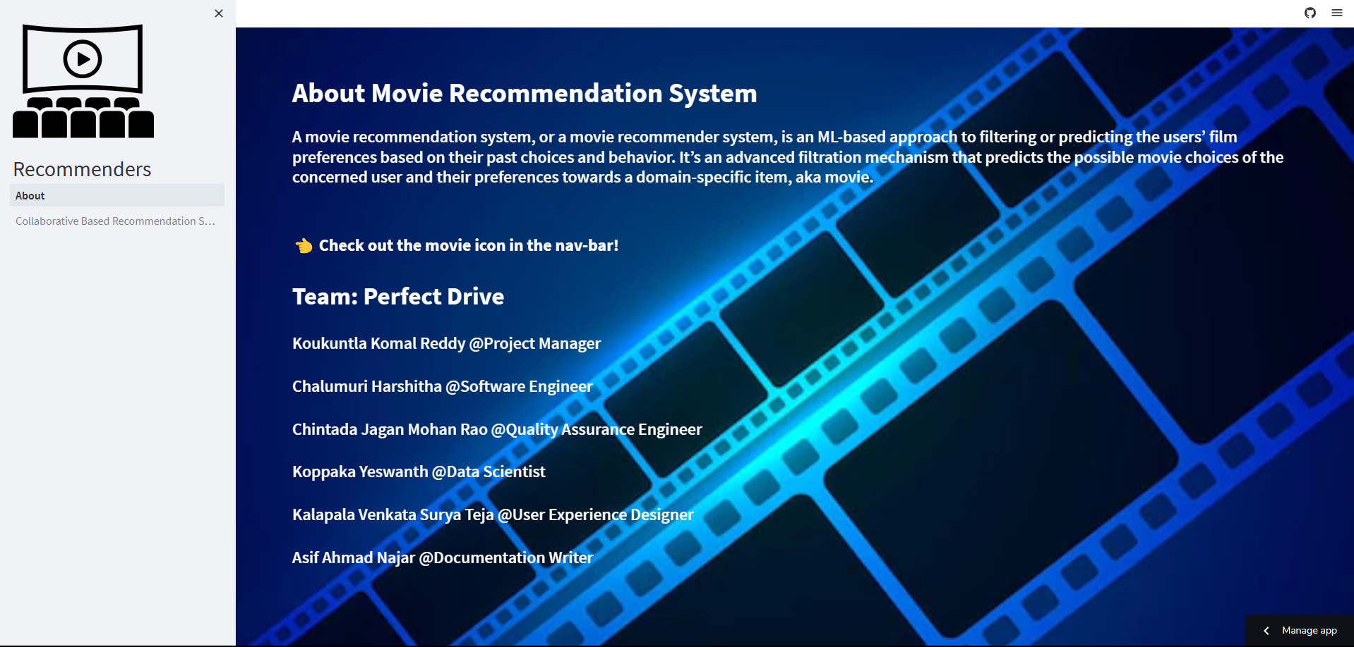

Slide 28
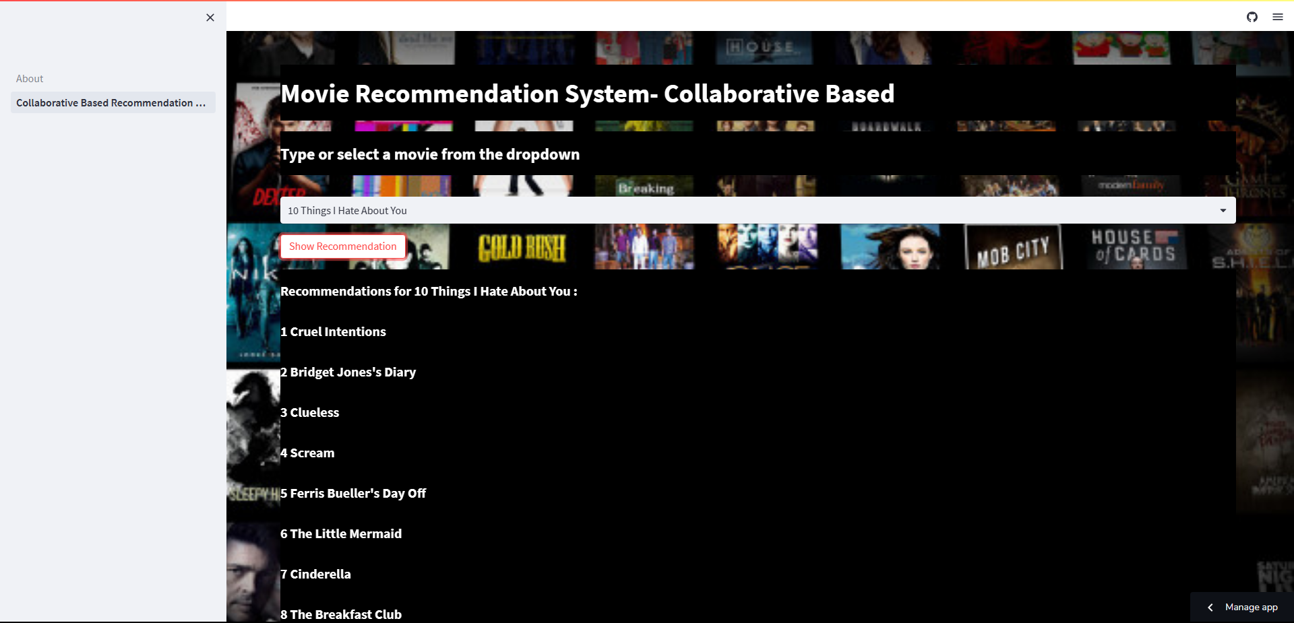

Slide 29
Code
komalreddy3/MovieRecommendationSystem: Movie Recommendation System using Collaborative Method (User - User similarity , Item-Item similarity) (github.com)
Streamlit Link
About · Streamlit (komalreddy3-movierecommendationsystem-about-uy3xq4.streamlit.app)

Slide 30

CHALLENGES FACED AND IMPROVEMENTS

Slide 31
June 2nd 2023 -> Collaborative based recommendation system's accuracy is improved by 12% using GridsearchCV . GridSearchCV is the process of performing hyperparameter tuning in order to determine the optimal values for a given model. The model as well as the parameters are entered. After extracting the best parameter values, predictions are made.
June 3rd 2023 -> We had our Recommendation system ready . But had to make a few changes to make it more accurate by adding more intents
June 4th 2023 -> we had our Recommendation system up and running. we used Streamlit which is an open-source app framework that provides useful tools and features that make creating web applications in Python easier

Slide 32

TIMELINE

Slide 33

Timeline
25 May 2023
Data cleansing
Data preprocessing
EDA
27 May 2023
Building Model
29 May 2023
Model Serialization and Deserialization
4 June 2023
Deployment
5 June 2023
Final Report Generation

Slide 34

References

Slide 35
https://www.sciencedirect.com/science/article/pii/S1574013715300150
Recommender Systems — User-Based and Item-Based Collaborative Filtering | by Carlos Pinela | Medium
Build a Recommendation Engine With Collaborative Filtering – Real Python
Enhanced Content-Based Filtering Using Diverse Collaborative Prediction for Movie Recommendation | IEEE Conference Publication | IEEE Xplore

Slide 36
THANK YOU
FROM TEAM
Project manager: @ Koukuntla Komal Reddy
Data scientist: @ Koppaka Yeswanth
Software engineer: @ Chalumuri Harshitha
User experience designer: @ Kalapala Venkata Surya Teja
Documentation writer:@ Asif Ahmad
Quality assurance engineer:@ Chintada Jagan Mohan Rao

